Slide 1
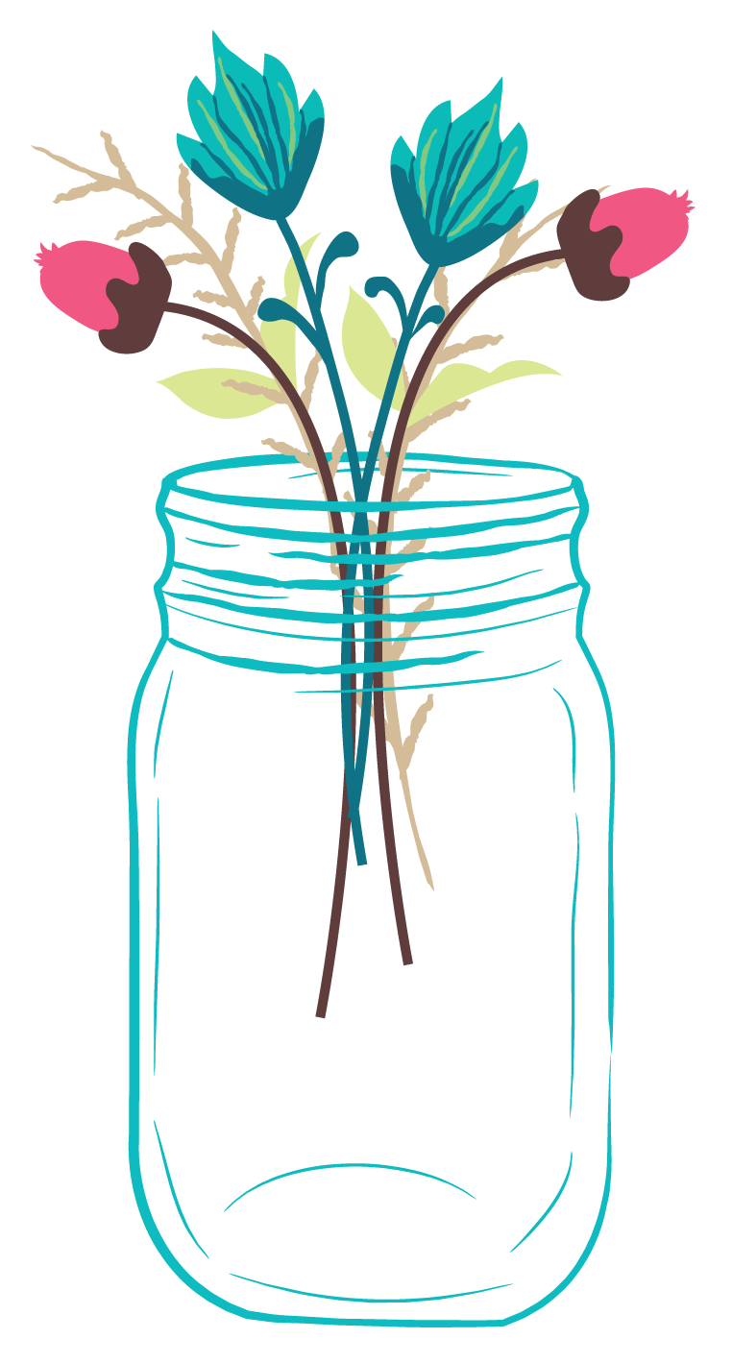
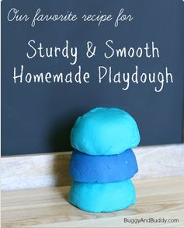
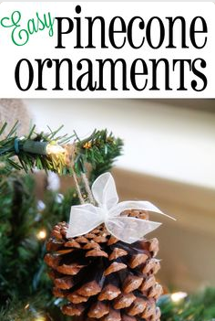
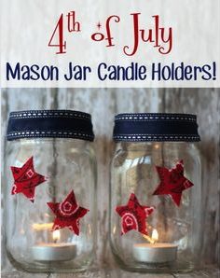

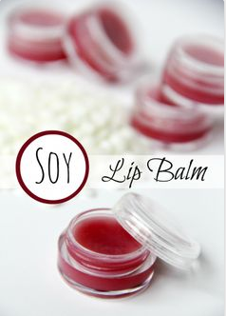
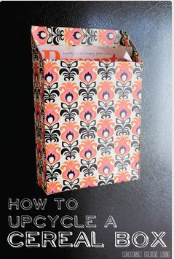
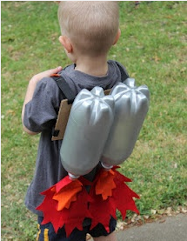
GoodyMaker
Create Items with What You Already Have
Search
I have…
You Can Make…
Add Ingredient
Coconut Oil, Beeswax, Paint, Scissors, Paper, Thread
I want to make…
Natural Cleaning Product
Kid’s Project
Beauty Product
Home Decor
Organizing Item
Difficulty Level I Time
Easy
< 10 min
Hard
> 1 Hr
You need, vitamin E
You need a cereal box.
You need empty soda bottles.
Notes:
Landing Page

Slide 2



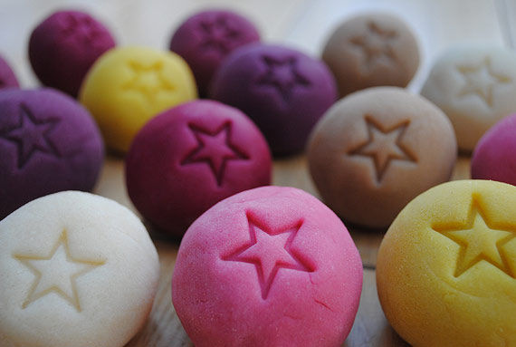
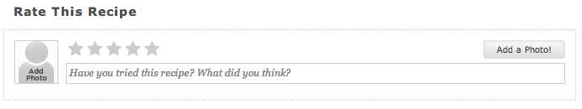
GoodyMaker
Create Items with What You Already Have
Sturdy & Smooth Homemade Playdough
Created by: Elmer’s Glue
Step 1: Make the dough….
Notes:
Rate This Recipe Comment was from: All-Recipes.com
Collection/Favorite/Download buttons are from: Instructables.

Slide 3
Competitors

Slide 4
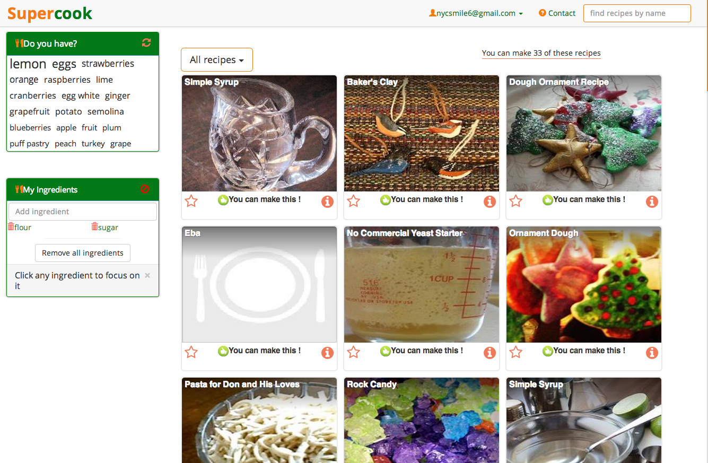
Notes:
www.SuperCook.com – These recipes all go to the source of the original recipe. For example, clicking on “Baker’s Clay” will bring you to AllRecipes on the following slide.

Slide 5
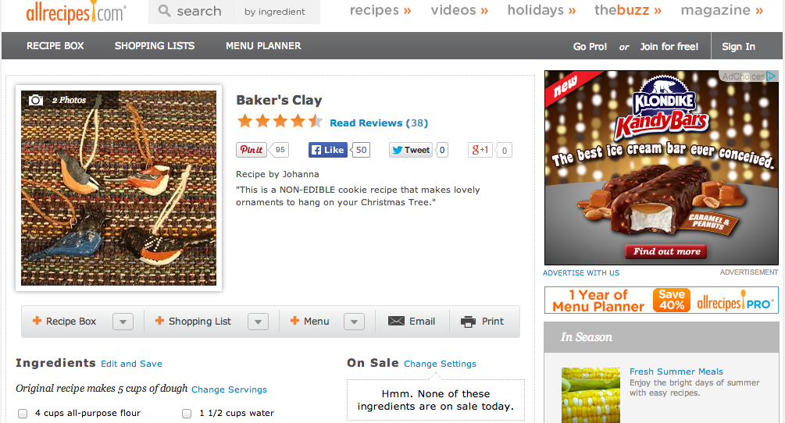
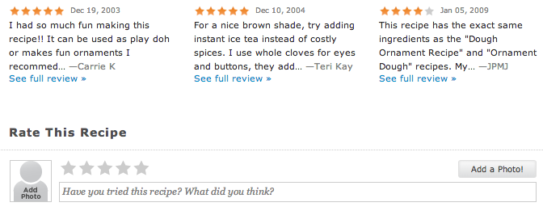
Notes:
www.AllRecipes.com

Slide 6
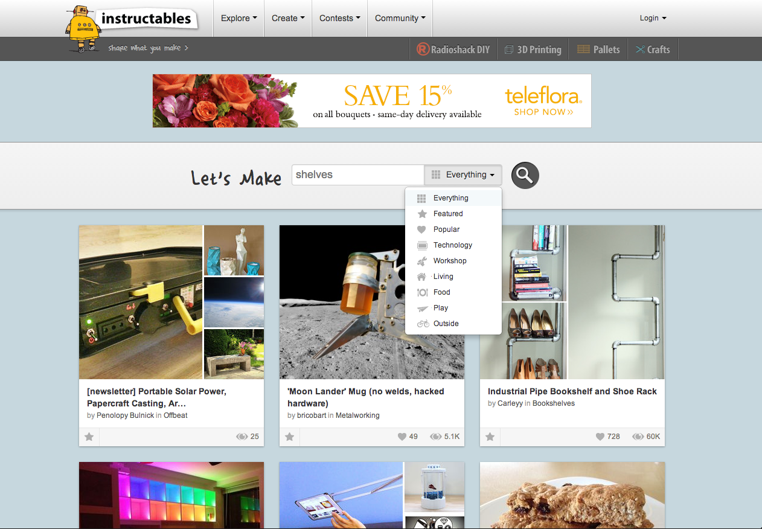
Notes:
www.Instructables.com
13 Million Unique Visitors a Month
http://www.forbes.com/sites/tjmccue/2012/01/13/share-what-you-make-with-instructables/

Slide 7
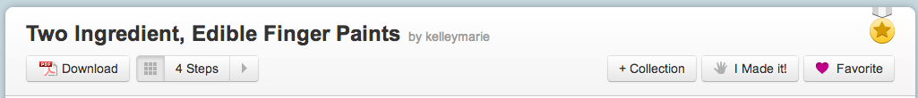
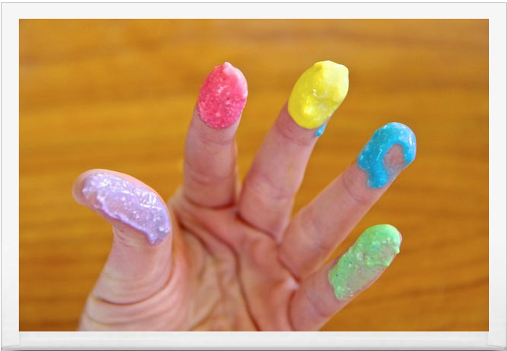
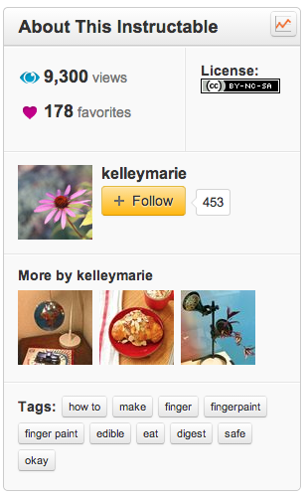
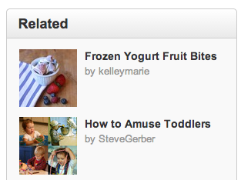
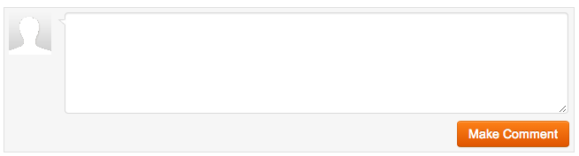
An easy recipe for edible, washable, and fun finger paint for kids and adults alike…
Notes:
www.Instructables.com
13 Million Unique Visitors a Month
http://www.forbes.com/sites/tjmccue/2012/01/13/share-what-you-make-with-instructables/

Slide 8
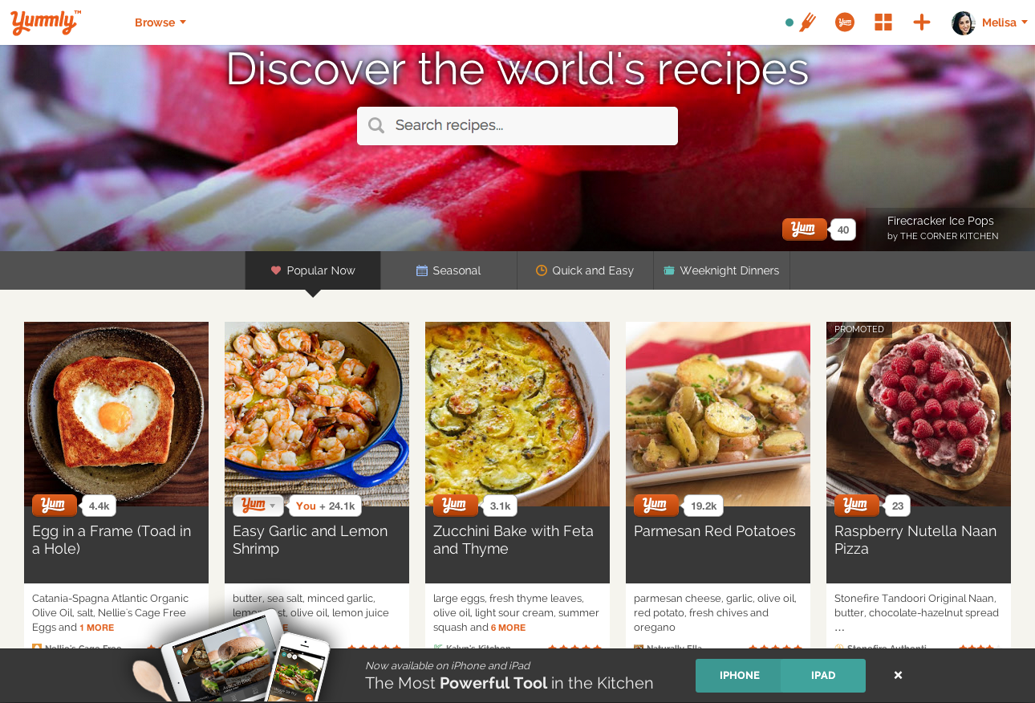
Notes:
www.Yummly.com - Got $6MM in Series A funding in 2012
http://www.forbes.com/sites/daniellegould/2012/03/23/yummly-poised-to-become-the-billion-dollar-digital-kitchen-platform/

Slide 9
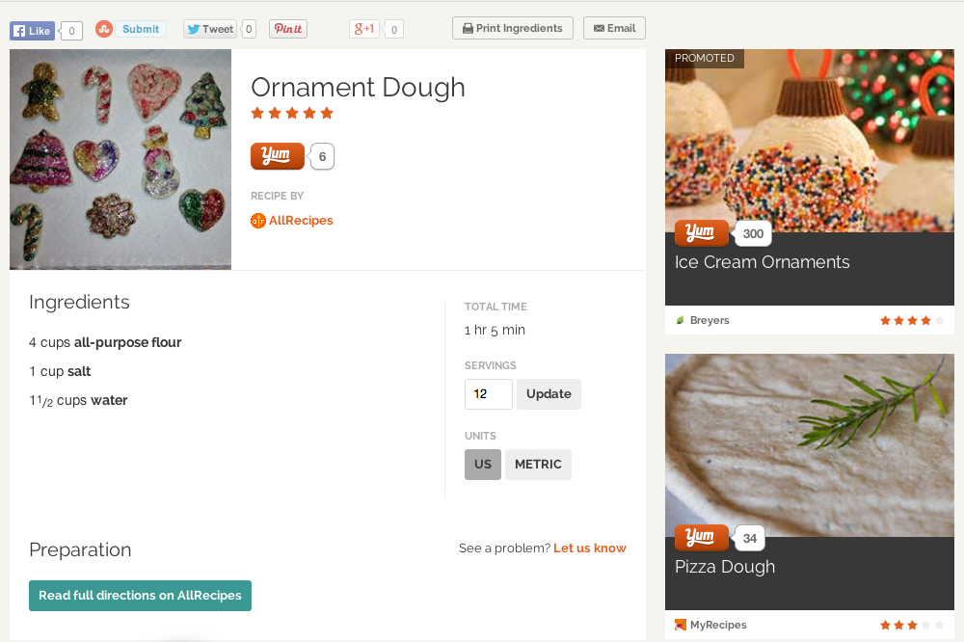
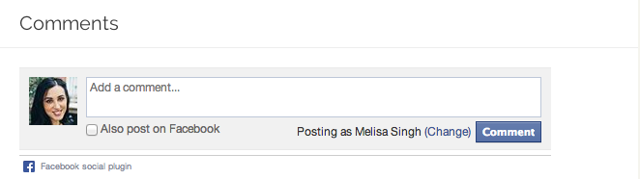
Notes:
www.Yummly.com - Got $6MM in Series A funding in 2012
http://www.forbes.com/sites/daniellegould/2012/03/23/yummly-poised-to-become-the-billion-dollar-digital-kitchen-platform/

Slide 10
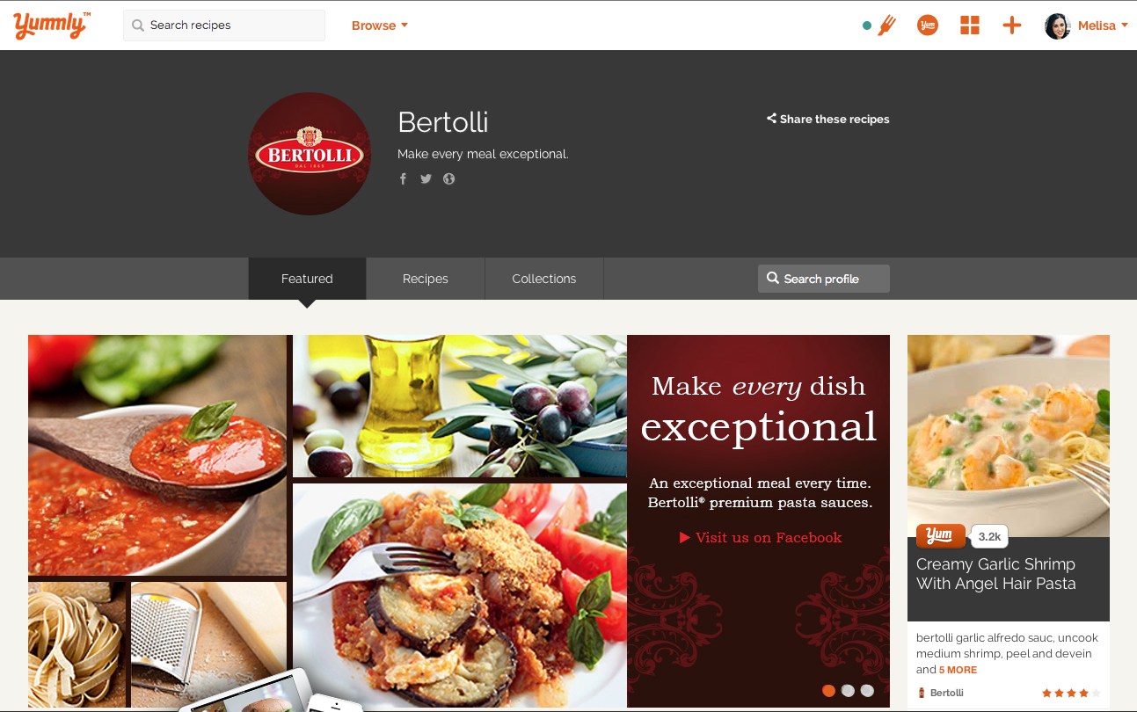
Notes:
www.Yummly.com - Got $6MM in Series A funding in 2012
http://www.forbes.com/sites/daniellegould/2012/03/23/yummly-poised-to-become-the-billion-dollar-digital-kitchen-platform/

